Slide 1
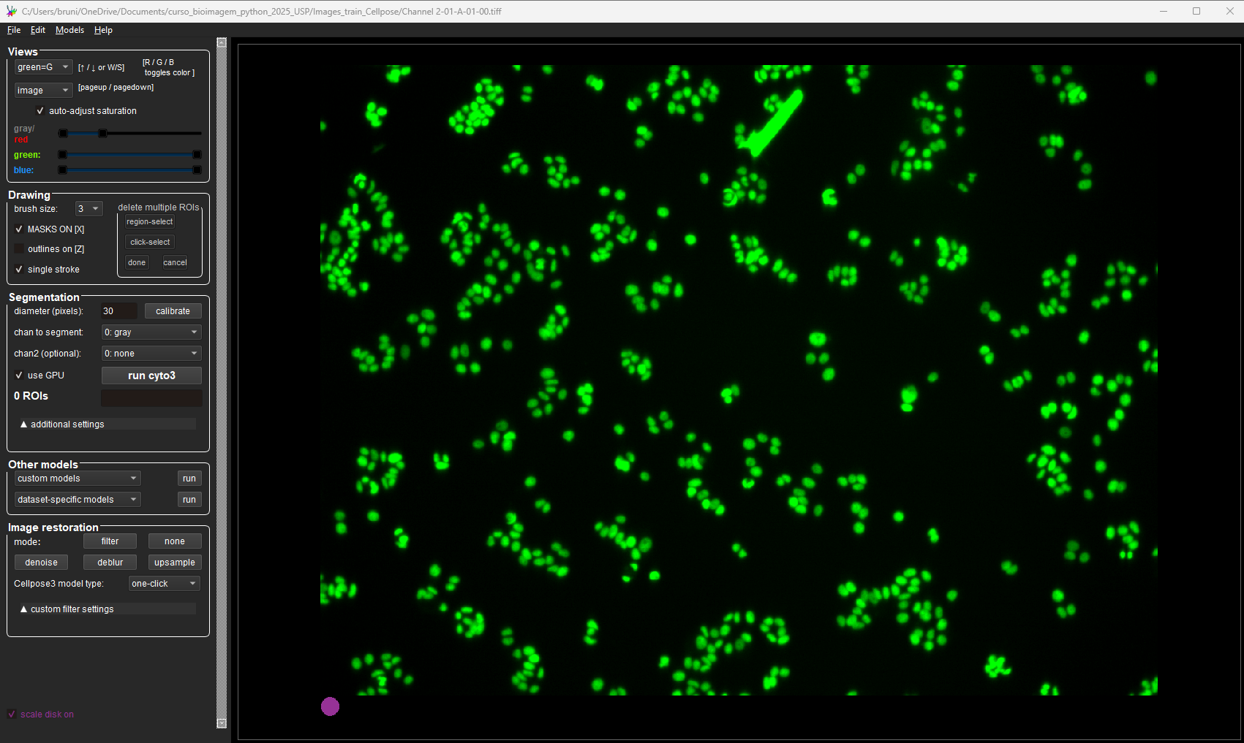
Cellpose GUI and train your own model with Cellpose

Slide 2

Cellpose has a very handy Graphical User Interface (GUI) that allows annotating/labeling cells, running built-in models and fine tune built-in models for your dataset using a ‘human-in-the-loop’ strategy
We are going to use a very small test dataset.
Bear in mind: The developers say we can achieve high accuracy by annotating between 600-1000 cells, but in my experience, depending on the type of data, you need much more!!

Slide 3
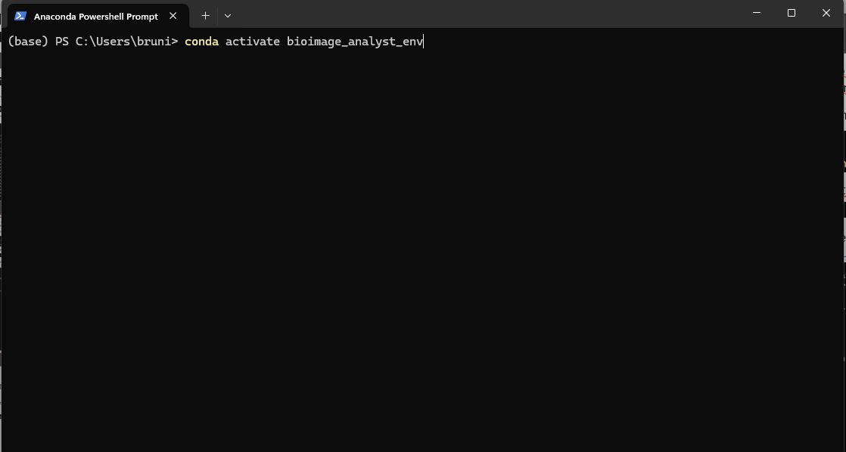
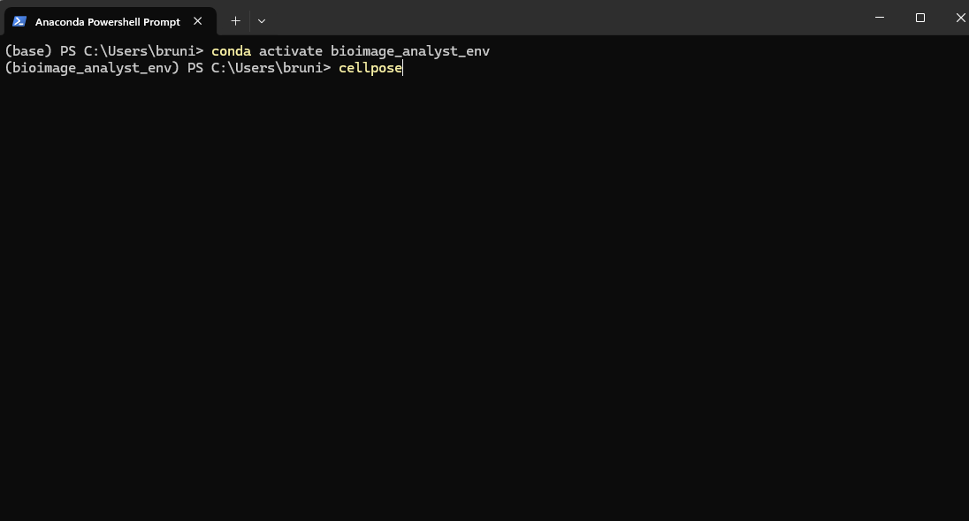
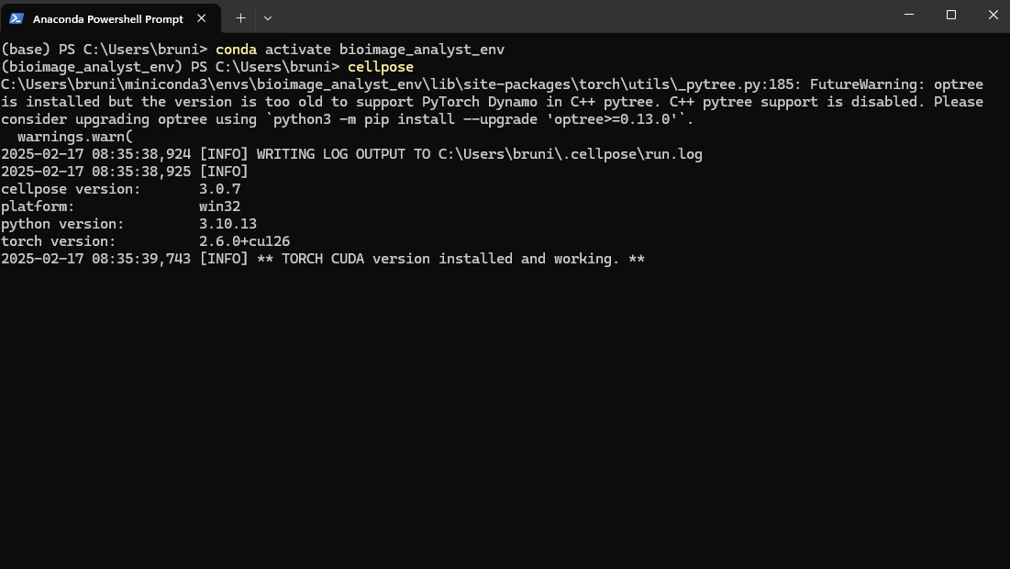

Slide 4
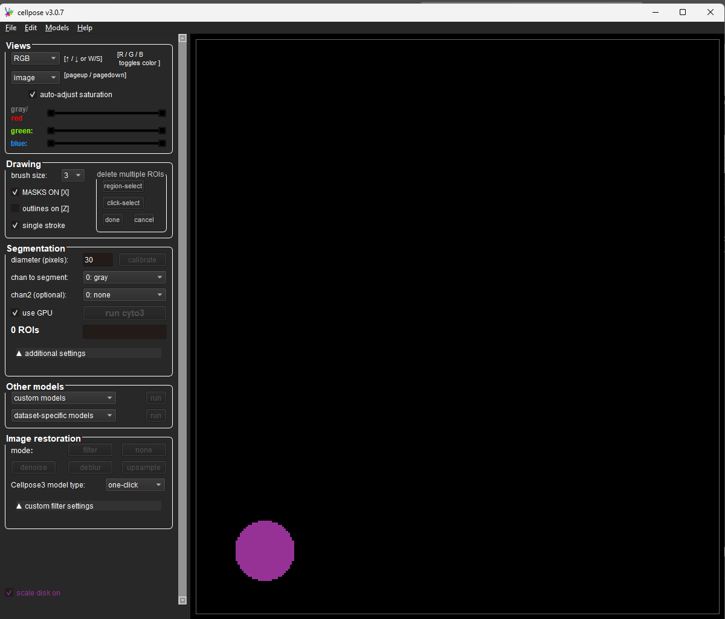
The GUI will pop up

Slide 5
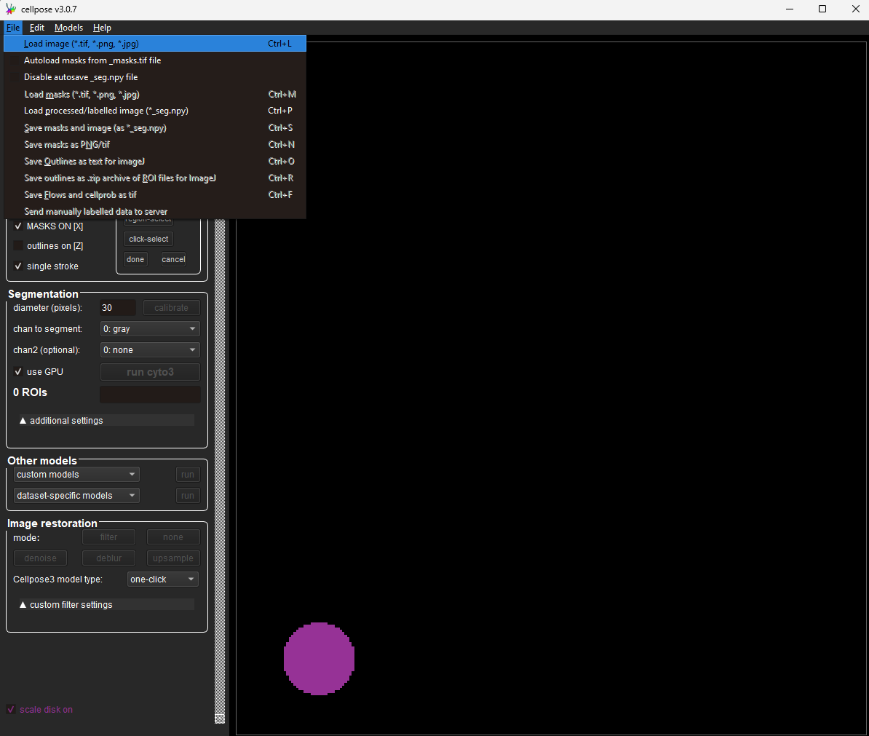

Slide 6
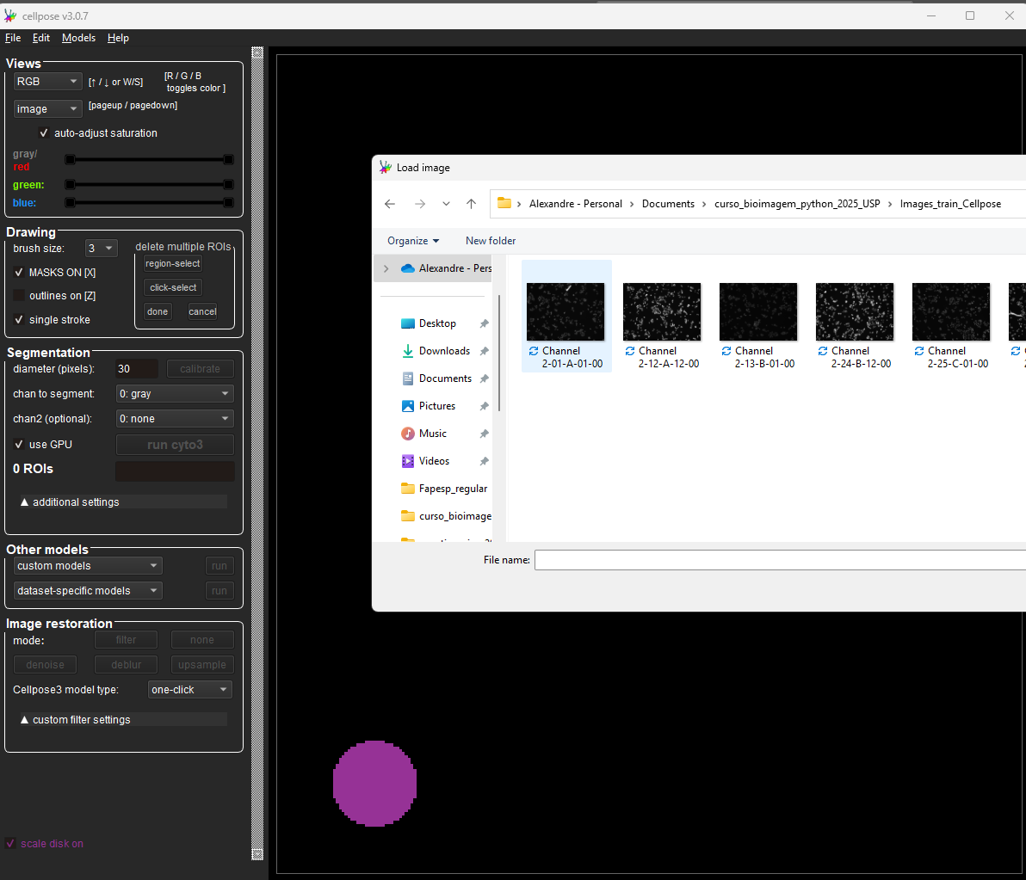

Slide 7
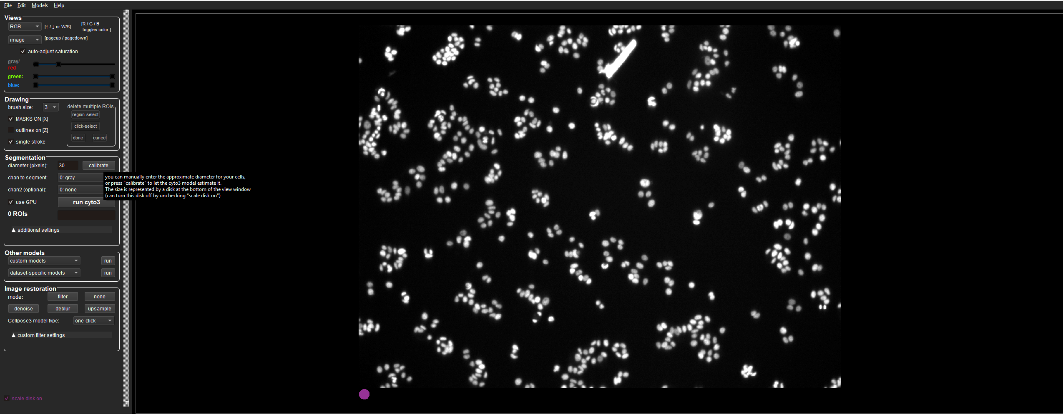
Calibrate the object diameter (nuclei in this case) – this is going to take a few minutes - The terminal will display the status

Slide 8
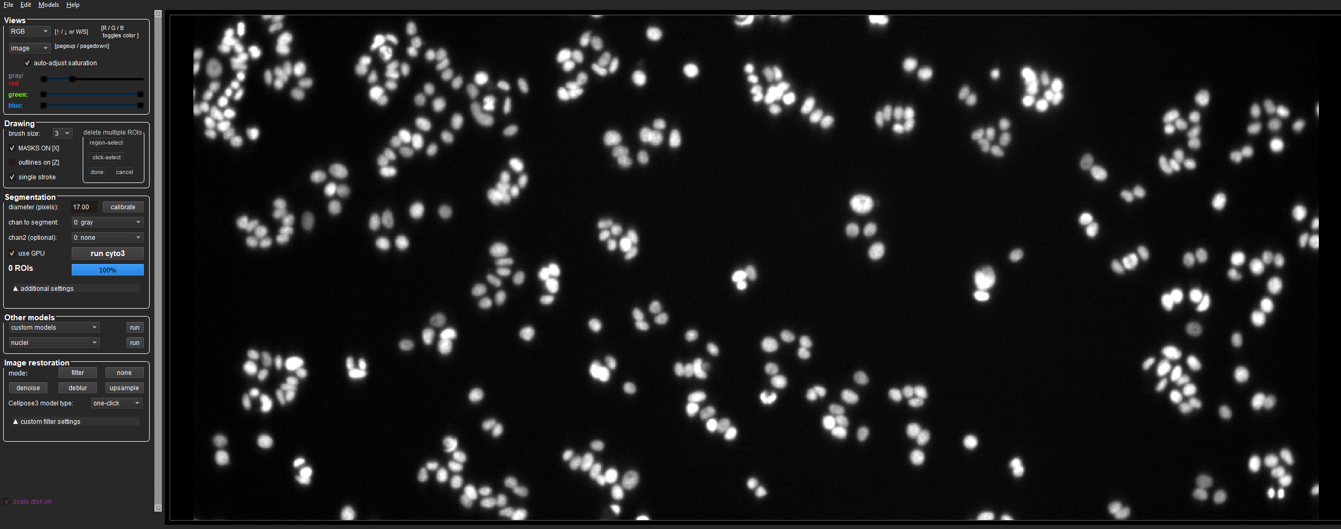

Slide 9
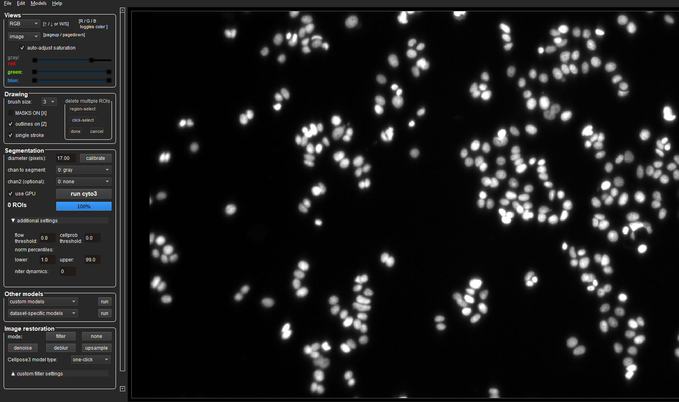
Adjust flow threshold to 0.8. Larger values if labels are too few. Smaller if too many labels are being made

Slide 10
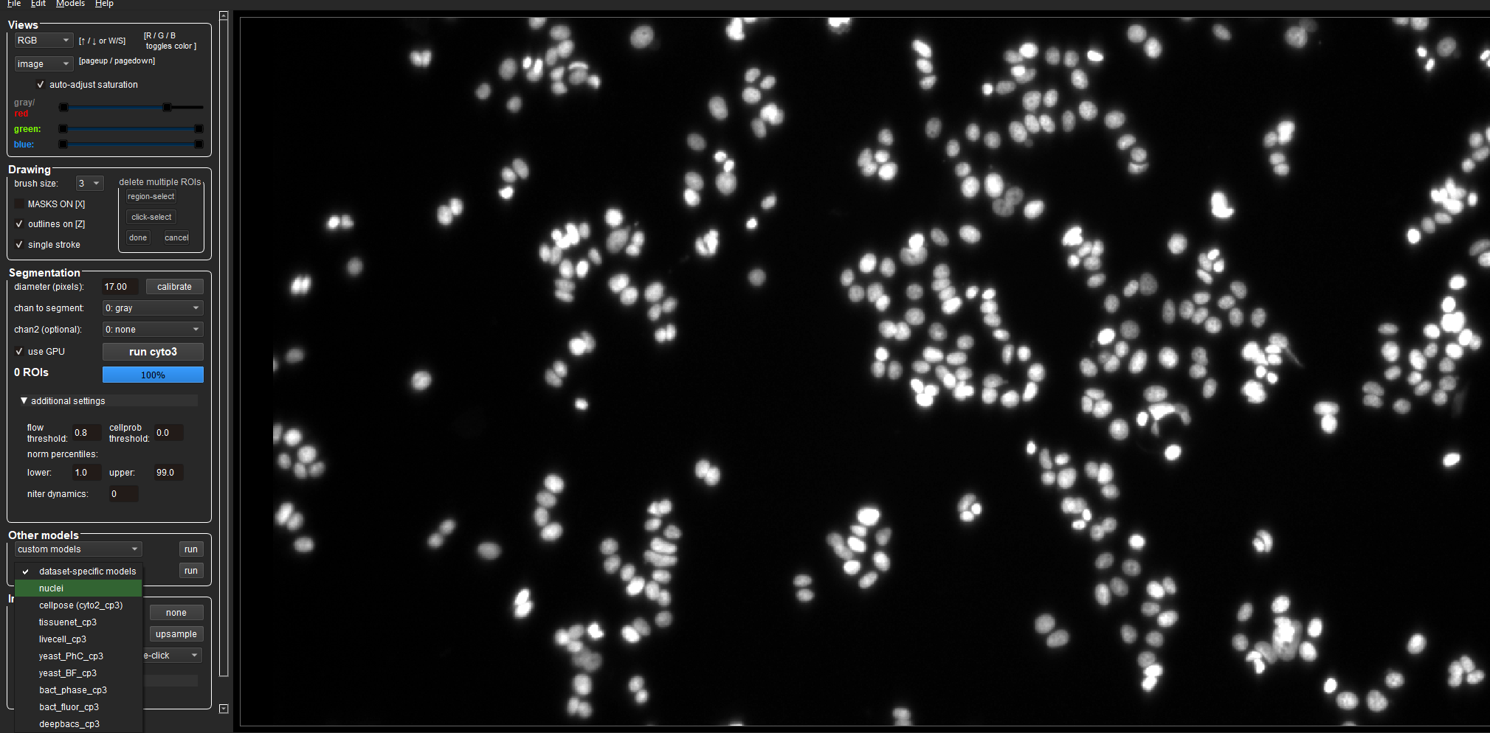
Choose nuclei from data-specific models and Run.
(Depending on your images, you can try Other models

Slide 11
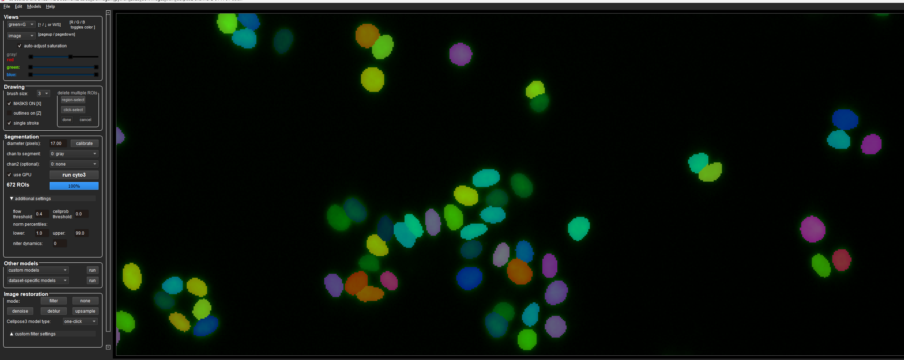
For better visualization, click on outlines and ‘unclick´masks on

Slide 12
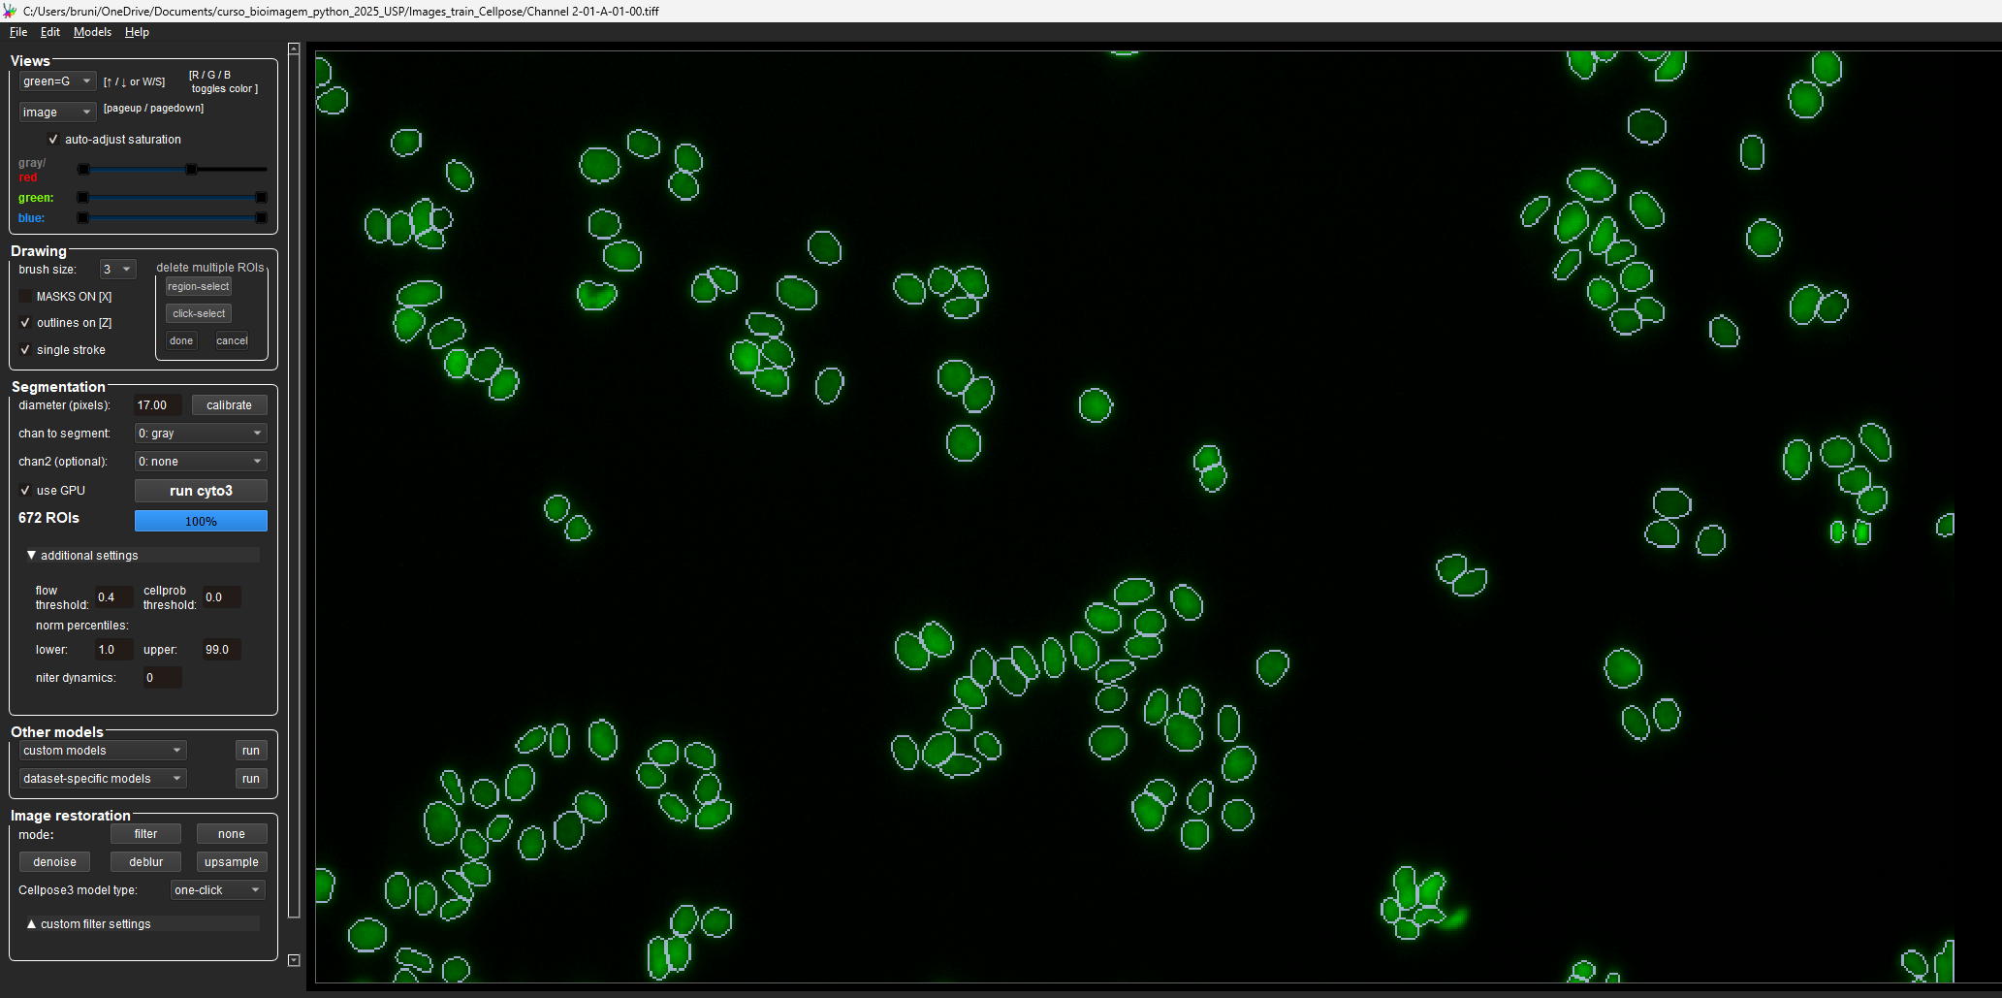
To delete labels – Ctrl + left button click
To redraw or draw a new cell label, right click once (do not need to hold it clicked) and circle the cell

Slide 13
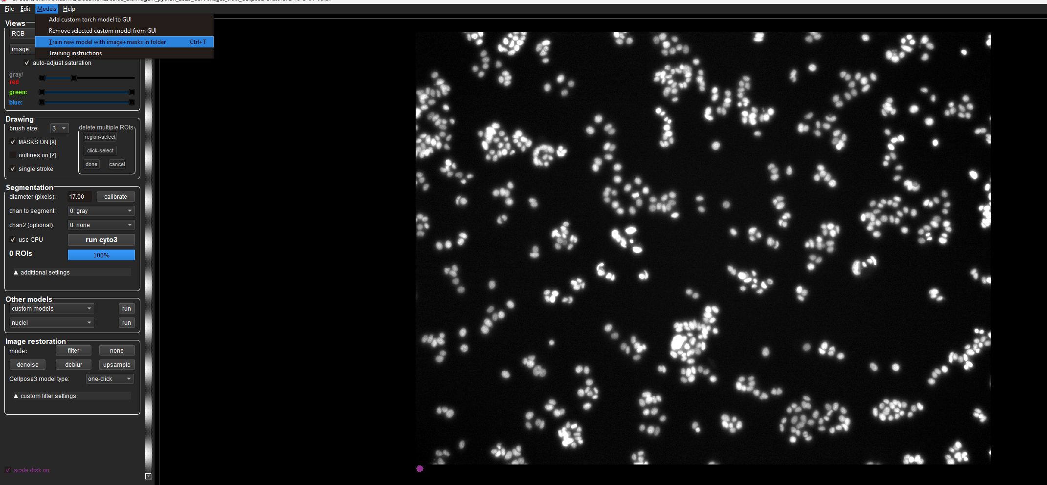

Slide 14
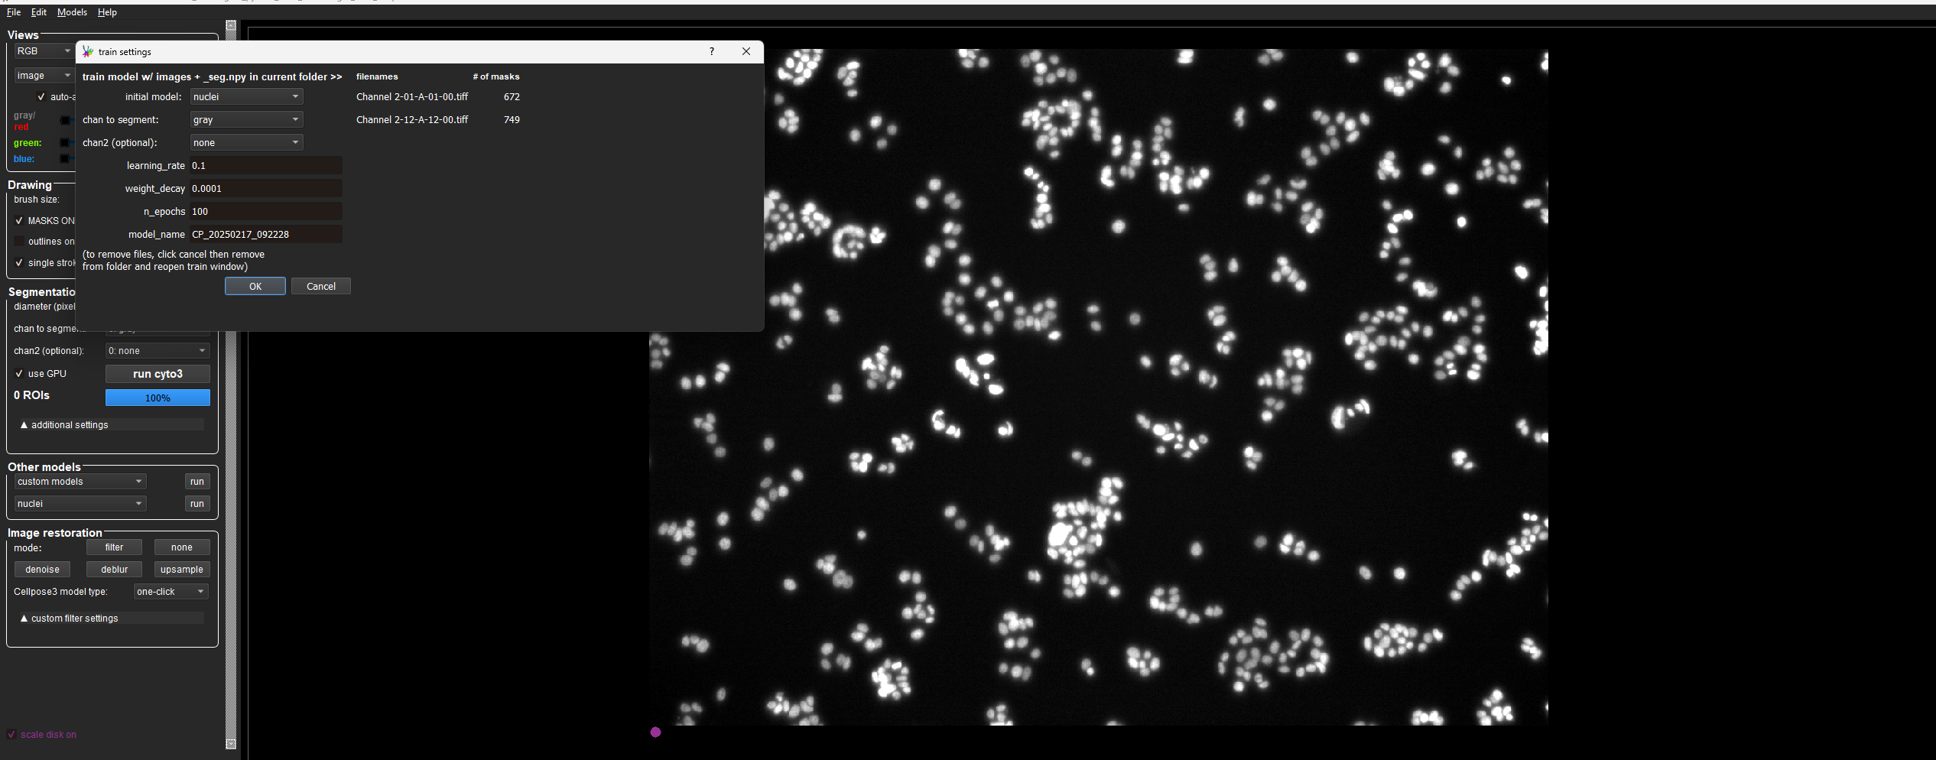
Name the model (i.e. my_model)

Slide 15
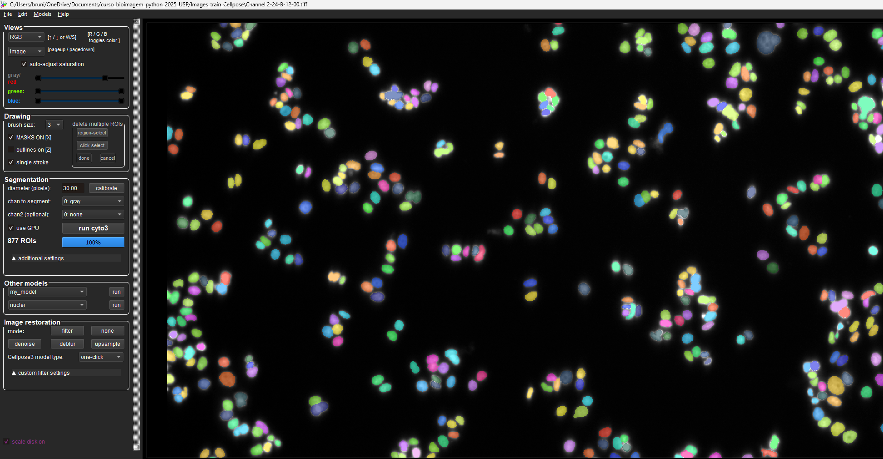
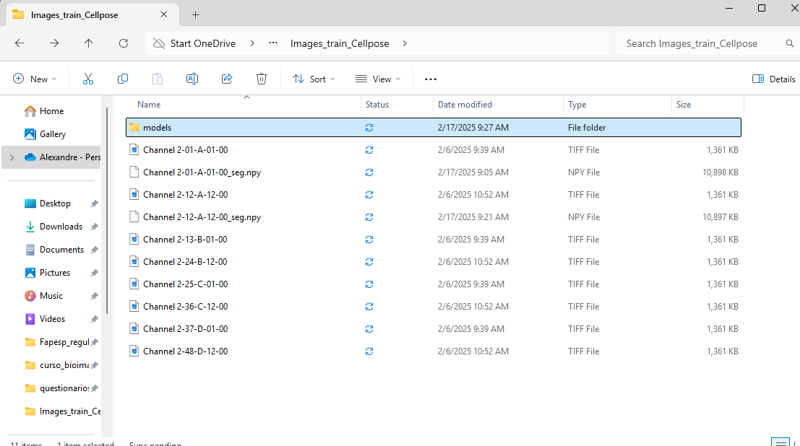
Your model will show up here. You can either use it from the GUI or via code
Your model file will be saved in the same folder as your images

